Slide 1
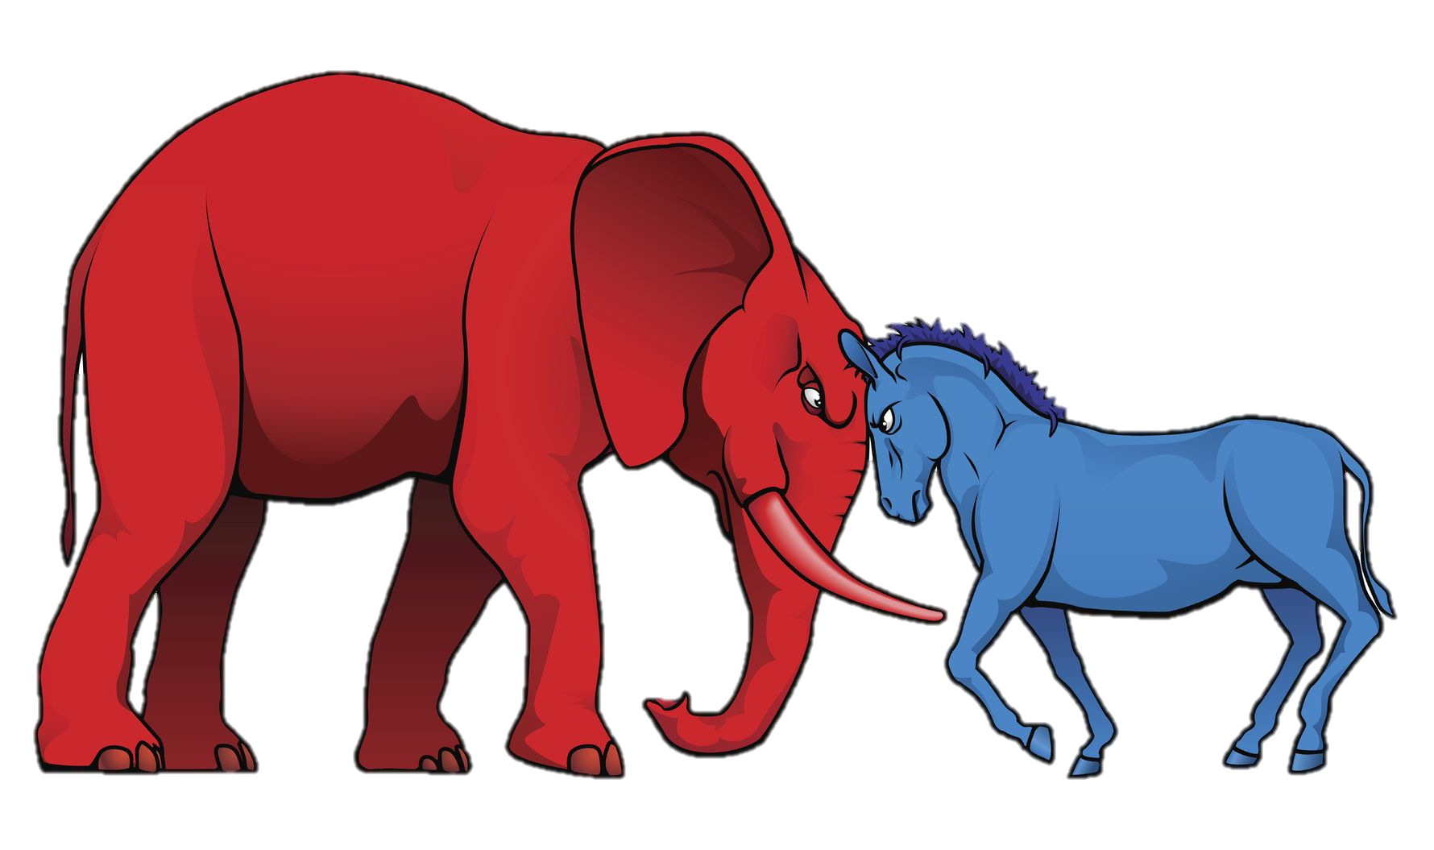
Party Identification

Slide 2
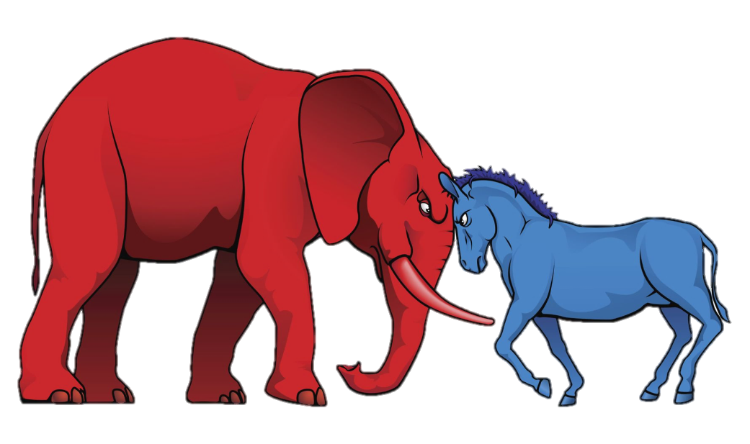
objectives
In what ways do people identify with political parties?
What factors influence party preference?

Slide 3
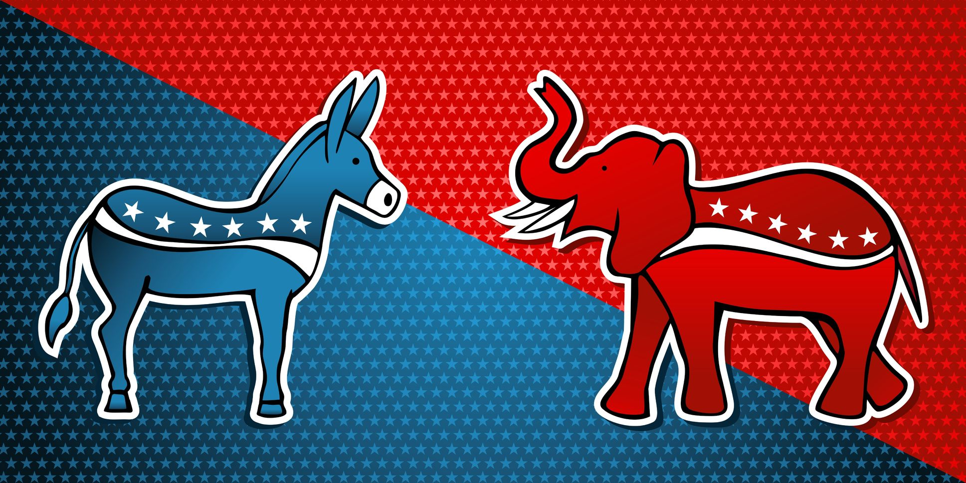
The Simple Version
DEMOCRATS | INDEPENDENTS | REPUBLICANS

Slide 4
The Simple Version
DEMOCRATS | INDEPENDENTS | REPUBLICANS
30% | 45% | 25%

Slide 5
Nearly half of the electorate self-identifies as independent.

Slide 6
Expressions of Party Preference
Voter Registration
Self-Identification
Tendency to Support Party
Candidates
Policies
Voting in Primary Elections
Open vs Closed

Slide 7
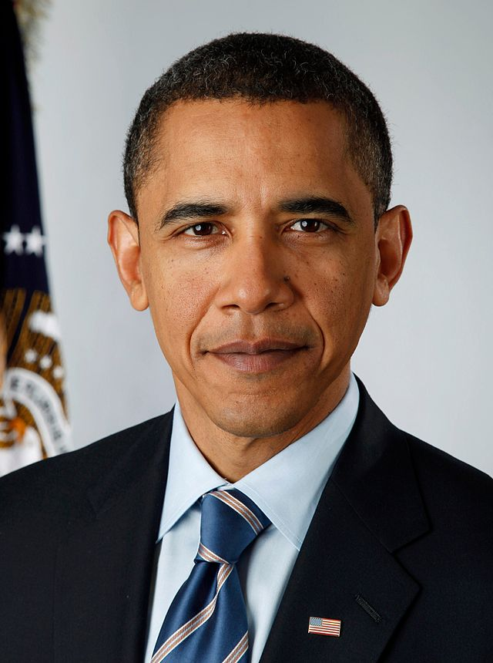
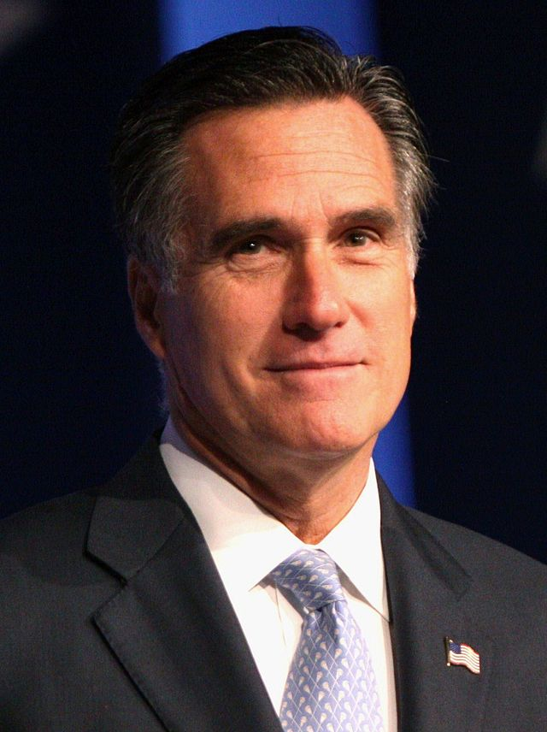
98.3%
Voted for one of the two major party candidates in the 2012 election.
Photo by Pete Souza
Photo by Gage Skidmore
51.1% | 1.7% | 47.2%

Slide 8
LEANERS

Slide 9
Some Independents Lean Left

Slide 10
Some Independents Lean Right

Slide 11
98.3%
Chose a party when it came crunch time.
Photo by Pete Souza
Photo by Gage Skidmore
51.1% | 1.7% | 47.2%

Slide 12
The Complex Version
DEMOCRATS |  | INDEPENDENTS |  |  | REPUBLICANS
STRONG | WEAK | LEANS | INDEPENDENT | LEANS | WEAK | STRONG

Slide 13
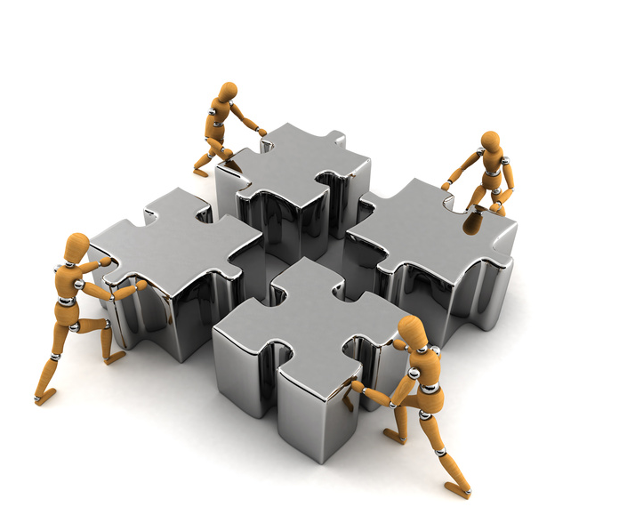
Realignment
As coalitions shift between parties, so do individuals.

Slide 14
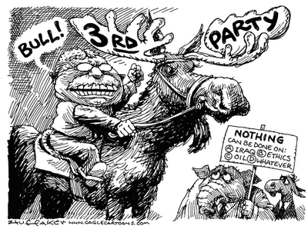
Deallignment FRQ with graph

Slide 15
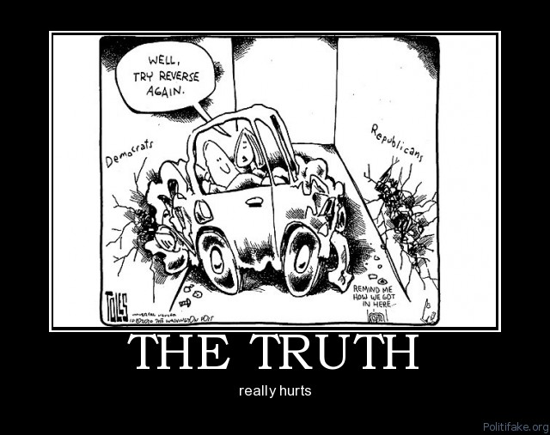
2 Party System
http://thedailyshow.cc.com/videos/mx5cx0/the-correspondents-explain---political-parties---the-two-party-system
Advantages/Disadvantages - Multiparty System???
Proportional Representation vs Winner Take All
Polarization

Slide 16
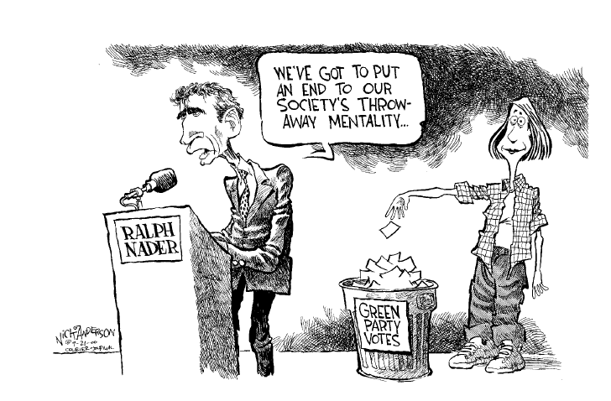
What about 3rd parties? -www.presidentelect.org
Why run for office?
Contributions?
Why do we not vote for them?

